Slide 1
VL-AI

Slide 2
Flow Diagrams

Slide 3
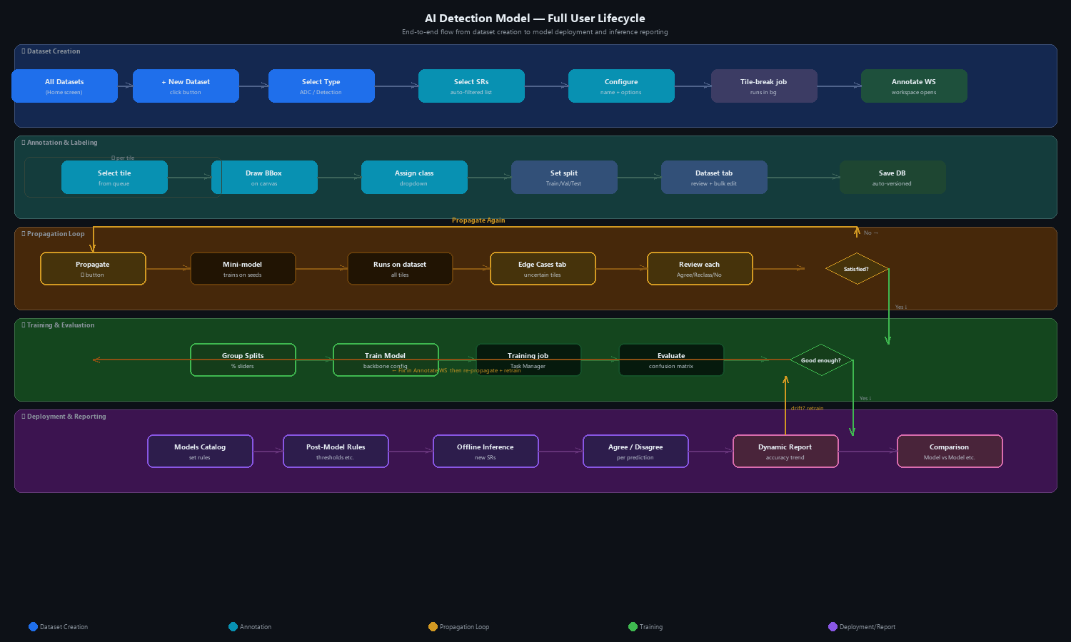
Flow 0 — Full Lifecycle Overview
Notes:
End-to-end user journey: Dataset Creation → Annotation → Propagation Loop → Training & Evaluation → Deployment → Inference → Reports & Comparison. Five horizontal phase lanes with connection arrows and decision points.

Slide 4
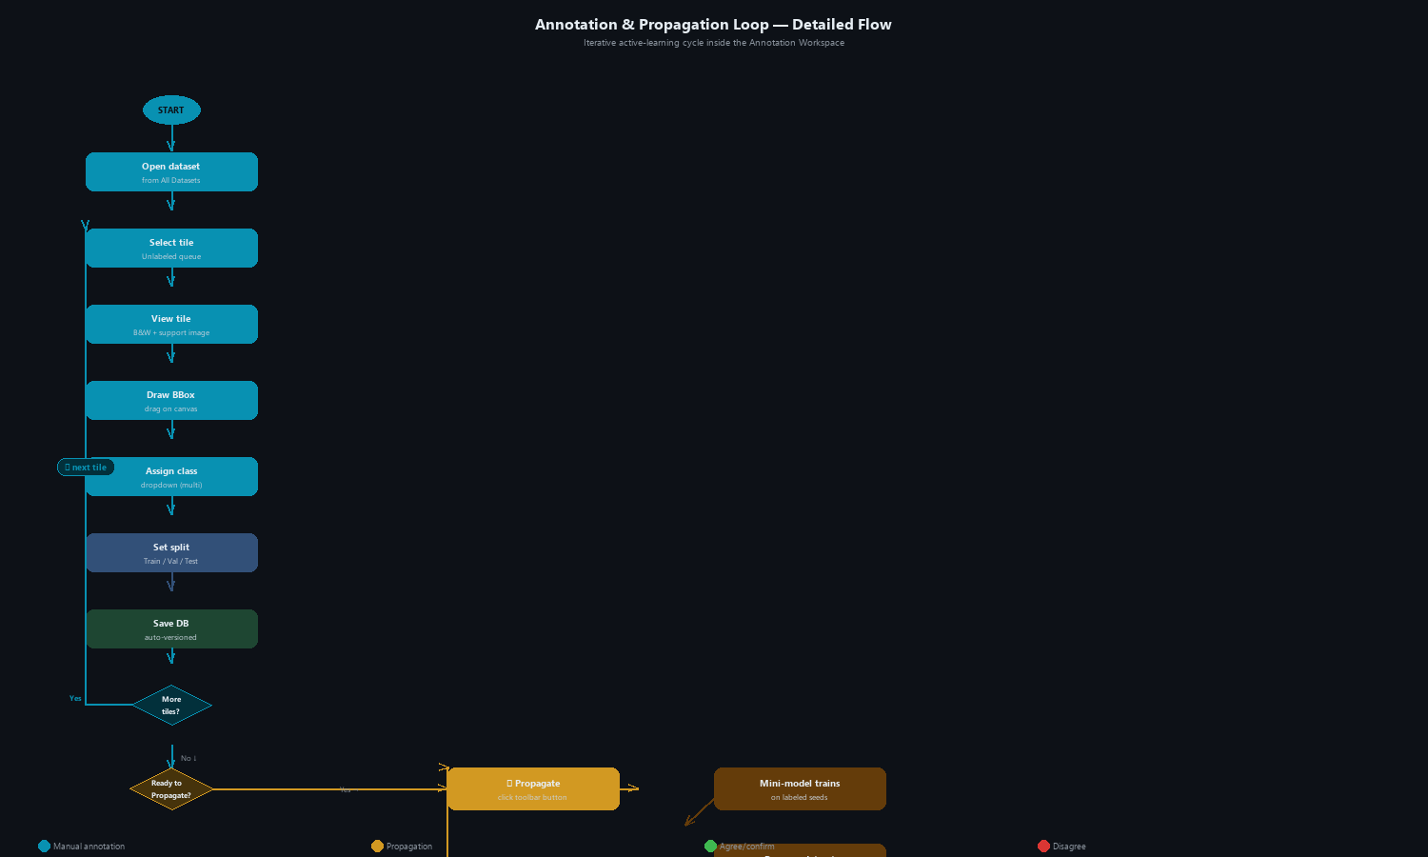
Flow 1 — Annotation & Propagation Loop (Detailed)
Notes:
Detailed iterative active-learning cycle inside the Annotation Workspace. Left column: manual annotation per tile. Center: Propagate → mini-model → proposals. Right: Edge Cases review (Agree / Reclassify / Not a defect). Loop repeats until user is satisfied with coverage, then proceeds to Train Model.

Slide 5
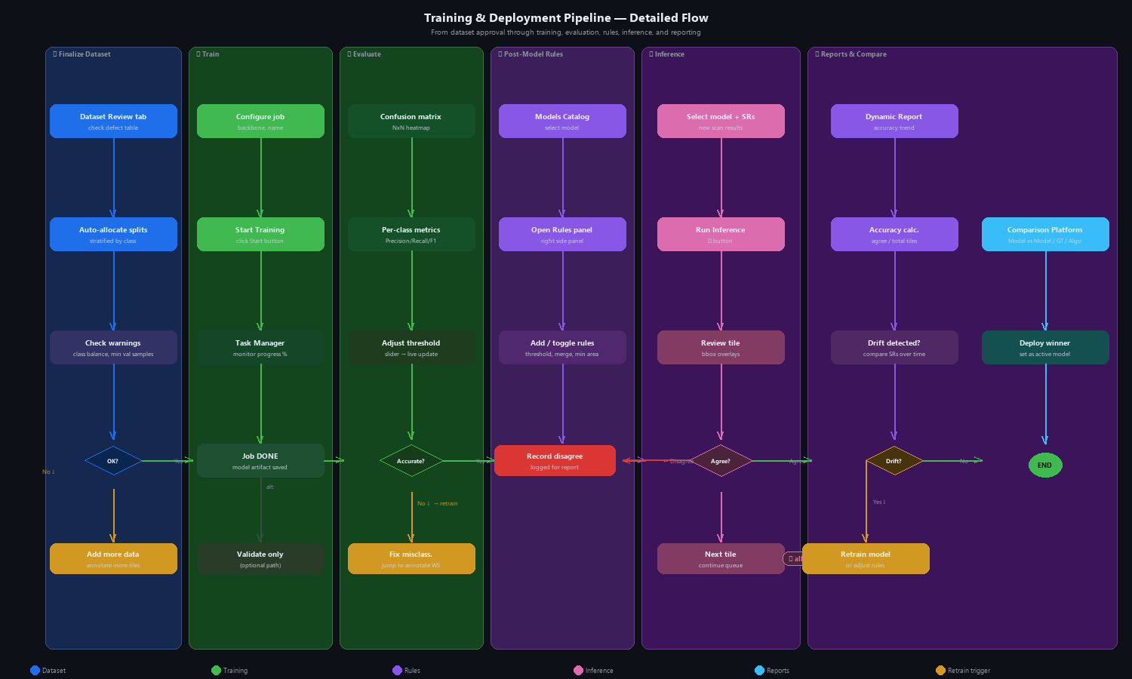
Flow 2 — Training & Deployment Pipeline (Detailed)
Notes:
Six-phase pipeline: ① Finalize dataset splits → ② Configure & train model → ③ Evaluate (confusion matrix, threshold) → ④ Post-model rules → ⑤ Offline inference (Agree/Disagree per tile) → ⑥ Dynamic report + comparison. Decision gates trigger retrain or rules adjustment on drift or poor accuracy.

Slide 6
User Story

Slide 7
Flow 1 — Dataset Creation
From the home screen to a ready-to-annotate dataset workspace. Covers: All Datasets → Create New Dataset wizard (type selector, SR list, configure).
Step 1 — Open All Datasets
User opens the VL platform. The home screen shows the All Datasets grid — card-per-dataset, each with a type badge (ADC = blue, AI Detection = purple) and a status badge (READY / DRAFT / ERROR).
User can filter by Type, Job, Status or search by name using the chip-style filter bar.
Step 2 — Click '+ New Dataset'
User clicks the + New Dataset button (top-right).
The Create New Dataset wizard opens. A left-side step panel shows the 3 setup stages.
Step 3 — Select Dataset Type
Wizard Step 1 of 3. Two cards are displayed:
• ADC Classification — classify pre-detected defect tiles. One defect per image. Task: assign class label.
• AI Detection — detect & classify defects in full scan images. Multiple defects per image. Task: draw bounding boxes + assign class.
User clicks the appropriate card. Type cannot be changed after dataset creation.
User clicks Next →.
Step 4 — Select Scan Results
Wizard Step 2 of 3. The system automatically filters scan results to show only SRs that meet the selected type's requirements (TIFF images present, compatible format).
Incompatible SRs are hidden or shown greyed-out with a reason tooltip (⚠ No TIFF).
User applies additional filters (Job, Recipe, Tool, Date) or searches by SR name.
User selects one or more SRs using checkboxes.
A footer shows: N scan results selected (X tiles total).
User clicks Next →.
Step 5 — Configure Dataset
Wizard Step 3 of 3.
User enters a Dataset name (auto-suggested from SR names).
For AI Detection type: optional toggle Use detection annotation — if ON, the system auto-proposes initial bounding boxes before manual refinement.
User clicks Create Dataset.
A tile-break job starts in the background (visible in Task Manager).
When complete, the dataset's Annotation Workspace opens automatically.
Notes:
Flow 1 — Dataset Creation
• Step 1 — Open All Datasets
• Step 2 — Click '+ New Dataset'
• Step 3 — Select Dataset Type
• Step 4 — Select Scan Results
• Step 5 — Configure Dataset

Slide 8
Flow 2 — Annotation & Labeling
Manual defect annotation inside the Annotation Workspace. Covers: tile navigation, bounding boxes, class assignment, split tagging, Dataset Review tab.
Step 1 — Navigate the Tile Queue
The Annotation Workspace opens on the Annotate tab. The left panel shows the tile queue with two sub-tabs: Unlabeled and Labeled.
User selects a tile from the queue (thumbnail + tile number + defect count shown per row).
Alternatively, user types a Tile / Frame / Die # into the Jump input and clicks Go.
Filter pills (Has BBox, Class ▾, Split ▾) narrow the visible queue.
A mini wafer map at the bottom shows tile positions; clicking a dot navigates to that tile.
Step 2 — View the Tile
The center canvas shows the selected tile's image in B&W mode.
The user can toggle to Support Image (neighbor die, shown with a cyan border) to compare context.
Zoom controls (100%, fit, 1:1) and pan are available.
Step 3 — Draw Bounding Boxes
User draws a bounding box by clicking and dragging on the canvas. A new bbox appears with a default outline color.
Multiple boxes per tile are supported (multi-class per tile).
User can resize a box by dragging its corners/edges.
To remove a box: select it in the BBox list panel (right Inspector) and click Del.
To clear all: click Delete all annotations in the Tile actions section.
Step 4 — Assign Defect Class
In the right Inspector panel, under Defect class, user selects the class from a dropdown.
Multiple boxes on a single tile can each have their own class (e.g., one Surface box, one Via box).
The bbox outline color changes to reflect the assigned class.
Step 5 — Set Split (Train / Val / Test)
In the Allocate tile to section of the Inspector, user selects Train, Validation, or Test for the current tile.
Alternatively, splits can be bulk-assigned later via the Dataset tab → Auto-allocate.
Step 6 — Save and Continue
User clicks Save DB (toolbar, bottom of canvas) to persist all annotations.
Tile moves from the Unlabeled to the Labeled sub-tab.
User selects the next tile and repeats. The cycle continues until enough seeds are ready for propagation.
Step 7 — Review in Dataset Tab
The Dataset tab (4th tab in the workspace) shows a cross-tile defect table — all defects from all tiles in one sortable view.
Columns: Tile #, Class (color pill), Split (inline editable dropdown), BBox W×H, Area, Die (X,Y), Confidence, Actions.
Inline split edit: click the Split cell → dropdown opens.Go to tile action jumps back to the Annotate tab with that tile focused.
Bulk reassignment: select multiple rows → Set all to Train / Val / Test.
Auto-allocate button opens the Group Splits modal.
Notes:
Flow 2 — Annotation & Labeling
• Step 1 — Navigate the Tile Queue
• Step 2 — View the Tile
• Step 3 — Draw Bounding Boxes
• Step 4 — Assign Defect Class
• Step 5 — Set Split (Train / Val / Test)
• Step 6 — Save and Continue
• Step 7 — Review in Dataset Tab

Slide 9
Flow 3 — Propagation Iterative Loop
Active-learning cycle: label seeds → propagate → review edge cases → repeat. The entire loop lives inside the Annotation Workspace.
Step 1 — Annotate Seed Tiles
User manually annotates a representative sample of tiles (seeds) covering all defect classes.
No minimum count is enforced, but having at least 10–30 tiles per class is recommended for a meaningful first propagation.
Step 2 — Click Propagate
User clicks the ▶ Propagate button in the toolbar (teal, prominent).
A mini detection model is trained internally on the labeled seed tiles.
The model then runs on all unlabeled tiles in the dataset and proposes annotations.
Progress is shown in the Task Manager. When complete, results appear in the workspace.
Step 3 — Propagation Cycle Stats Bar Appears
A stats bar appears above the toolbar: Cycle N — Auto-labeled: X tiles | Edge Cases: Y | Manually labeled: Z.
This bar persists for all subsequent cycles, updating after each propagation run.
Step 4 — Review Edge Cases
The Edge Cases tab (orange badge, count shown) appears in the tile queue.
Each edge case tile shows: thumbnail, AI-proposed class, and confidence % (e.g., Surface 54%).
User selects a tile. The canvas shows the AI proposal with a dashed orange bbox (distinguishing it from confirmed solid-color bboxes).
A review bar below the canvas prompts: Is this annotation correct?
• ✓ Agree — confirms the AI proposal as-is.
• ↺ Reclassify ▾ — opens a class dropdown to change the assigned class.
• ✗ Not a defect — removes the proposed bbox entirely.
User navigates through edge cases with ← Prev / Next → buttons.
Step 5 — Manual Refinement
At any point during or after edge case review, user can switch back to the tile list and manually annotate or correct any tile.
Manually corrected tiles remain in the Labeled queue and are not re-proposed by the next propagation cycle.
Step 6 — Propagate Again
After reviewing edge cases and doing any manual corrections, user clicks ▶ Propagate Again.
The model retrains on the updated label set (original seeds + confirmed edge cases + manual corrections) and runs again.
The cycle counter increments. Edge Cases tab updates with new uncertain tiles.
Repeat Steps 4–6 until the user is satisfied with annotation coverage.
Step 7 — Proceed to Train Model
When the user is satisfied (edge cases are minimal, all important tiles are labeled), they click ✦ Train Model (green button, toolbar right).
This triggers the full production model training — separate from the mini propagation models.
Notes:
Flow 3 — Propagation Iterative Loop
• Step 1 — Annotate Seed Tiles
• Step 2 — Click Propagate
• Step 3 — Propagation Cycle Stats Bar Appears
• Step 4 — Review Edge Cases
• Step 5 — Manual Refinement
• Step 6 — Propagate Again
• Step 7 — Proceed to Train Model

Slide 10
Flow 4 — Group Splits & Train Model
Finalize train/val/test allocation, then configure and launch the production training job.
Step 1 — Open Group Splits Model
From the Dataset tab, user clicks Auto-allocate (or from the toolbar).
The Allocate Dataset Splits modal opens.
Step 2 — Configure Split Method & Strategy
Method: user selects Global percentage (recommended) or Manual per-tile.
Strategy: user selects Stratified by class (recommended — preserves class proportions in each split) or Random.
Step 3 — Set Percentages
Three sliders: Train, Validation, Test. Total must equal 100%.
Default: 70% / 15% / 15%.
A live preview table shows the resulting per-class sample counts.
Warning rows (red) flag classes with fewer than the minimum required validation samples.
Step 4 — Review Warnings and Apply
If a class has too few samples, a warning banner shows: ⚠ Via class has fewer than 10 validation samples.
User can go back to annotate more tiles for that class, or proceed accepting the limitation.
User clicks Apply & Save. Splits are saved to the DB.
Step 5 — Click Train Model
User clicks ✦ Train Model in the Annotation Workspace toolbar.
The Start Training Job modal opens.
Step 6 — Configure Training Job
Fields:
• Backbone / Architecture: select from dropdown (e.g., RF-DETR Nano).
• Dataset version: auto-stamped (read-only) — ensures reproducibility.
• Model name: user enters a descriptive name (e.g., Solder_Detection_v1).
• Advanced: collapsed section for Epochs, Learning Rate, Batch size.
A job summary shows Train / Val / Test tile counts and number of classes.
Step 7 — Start Training
User clicks Start Training.
The job appears in the Task Manager (sidebar icon) with a progress indicator.
When complete, the model appears in Models Catalog with status DONE and an F1 score.
Notes:
Flow 4 — Group Splits & Train Model
• Step 1 — Open Group Splits Modal
• Step 2 — Configure Split Method & Strategy
• Step 3 — Set Percentages
• Step 4 — Review Warnings and Apply
• Step 5 — Click Train Model
• Step 6 — Configure Training Job
• Step 7 — Start Training

Slide 11
Flow 5 — Evaluate & Iterate
Review model accuracy, identify misclassifications, and iteratively improve the model.
Step 1 — Open Evaluate & Report
From the Models Catalog, user clicks View on a DONE training job.
The Evaluate & Report screen opens, pre-loaded with the model's validation results.
Step 2 — Review the Confusion Matrix
A 5×5 heatmap (Actual rows vs Predicted columns) shows prediction quality at a glance.
Green diagonal cells = correct predictions. Red off-diagonal cells = misclassifications.
Cell values show raw counts.
Step 3 — Adjust Confidence Threshold
The Confidence threshold slider (default 0.35) filters out low-confidence predictions.
Dragging the slider updates the confusion matrix and per-class metrics live.
User sets the threshold that best balances precision vs. recall for the use case.
Step 4 — Review Per-Class Metrics
A table shows Precision, Recall, F1-score, and sample count per class.
Classes with low F1 are highlighted. An overall F1 badge is shown at the top-right.
A per-class horizontal accuracy bar chart provides a quick visual comparison.
Step 5 — Investigate Misclassifications
The Misclassifications table lists False Negatives and False Positives with tile number, class, and score.
User clicks Go annotate on a row — the Annotation Workspace opens with that tile focused.
User inspects the tile, corrects the bounding box or class, and saves.
Step 6 — Iterate
After fixing annotations:
1. Click ▶ Propagate to re-run the propagation cycle with updated labels.
2. Review new edge cases.
3. Click ✦ Train Model to retrain the model.
4. Return to Evaluate & Report and compare new F1 scores.
Repeat until accuracy targets are met.
Notes:
Flow 5 — Evaluate & Iterate
• Step 1 — Open Evaluate & Report
• Step 2 — Review the Confusion Matrix
• Step 3 — Adjust Confidence Threshold
• Step 4 — Review Per-Class Metrics
• Step 5 — Investigate Misclassifications
• Step 6 — Iterate

Slide 12
Flow 6 — Post-Model Rules & Models Catalog
Configure post-inference rules to refine model output, then deploy to the catalog.
Step 1 — Open Models Catalog
User navigates to Models Catalog (sidebar icon).
Two tabs: Training Jobs and Validation Jobs.
The Training Jobs table shows all past and running jobs: name, model, dataset, status (DONE / RUNNING / ERROR), F1, date.
Step 2 — Select a Model
User clicks a DONE job row. The row highlights.
Action buttons appear: View (open report) and Deploy (activate for inference).
Step 3 — Open Post-Model Rules Panel
The right-side Post-Model Rules panel opens automatically for the selected model.
The panel shows active rules applied after inference to adjust raw model predictions.
Step 4 — Configure Rules
Available rule types:
• Score threshold — minimum confidence required per class (e.g., Surface > 0.45).
• Merge overlapping — merge boxes with IoU > threshold (reduces duplicate detections).
• Min bbox area — discard boxes smaller than N pixels (noise filter).
• Max class count — limit maximum detections per class per image.
Each rule has a class selector (or 'All'), a condition value, and a toggle switch.
User clicks + Add Rule to create a new rule.
Step 5 — Toggle Rules
Each rule has an on/off toggle. Disabled rules are greyed out but preserved for future use.
Rules are applied in the order listed.
Step 6 — Save and Re-deploy
User clicks Save Rules → Re-deploy.
The model is re-registered with the updated rule set.
All future inference runs for this model will have the rules applied automatically.
Notes:
Flow 6 — Post-Model Rules & Models Catalog
• Step 1 — Open Models Catalog
• Step 2 — Select a Model
• Step 3 — Open Post-Model Rules Panel
• Step 4 — Configure Rules
• Step 5 — Toggle Rules
• Step 6 — Save and Re-deploy

Slide 13
Flow 7 — Offline Inference
Run the deployed model on new scan results and review predictions tile by tile.
Step 1 — Configure Inference Job
User opens Offline Inference (sidebar).
Left panel: select Model from dropdown, select Scan Results (checkboxes, new SRs not previously seen by the model), set Confidence threshold (slider).
User clicks ▶ Run Inference.
Step 2 — Monitor Progress
A progress bar shows % of tiles processed.
Job is also visible in Task Manager.
Live stats update: Detections, Agree, Disagree, Pending.
Step 3 — Review Predictions
Center canvas shows a tile with model prediction bboxes.
• Confirmed bbox = solid colored outline.
• AI proposal = dashed colored outline.
Support Image (neighbor die) shown alongside for context.
Right panel: tile info, bounding box list per detection.
Step 4 — Agree or Disagree
Below the canvas, a review bar prompts the user:
• ✓ Agree all — accepts all predictions for this tile as correct.
• ✗ Disagree — marks the tile's predictions as incorrect (logged for Dynamic Report).
• ↺ Reclassify — opens class dropdown to correct a specific detection's class.
User navigates with ← Prev / Next →.
A tile strip at the bottom shows recent tiles with green (agreed) or red (disagreed) borders.
Step 5 — Disagreements Are Logged
Every Disagree action is stored with: SR name, tile number, AI-predicted class, user-selected correction, and confidence score.
These records feed into the Inference Dynamic Report for accuracy analysis.
Notes:
Flow 7 — Offline Inference
• Step 1 — Configure Inference Job
• Step 2 — Monitor Progress
• Step 3 — Review Predictions
• Step 4 — Agree or Disagree
• Step 5 — Disagreements Are Logged

Slide 14
Flow 8 — Dynamic Report & Comparison Platform
Evaluate model accuracy over time using disagree data, then compare models to decide on deployment.
Step 1 — Open Inference Dynamic Report
User opens Inference Dynamic Report (sidebar).
Left panel shows available inference runs (SR name, date, tile count, accuracy %, disagree count).
Step 2 — Select Inference Runs
User selects 1 or more inference runs (checkboxes).
Clicks Update Report to load the analysis.
Step 3 — Review Accuracy Trend
A line chart shows Agree% per SR over time.
Declining accuracy signals model drift.
A drift warning badge appears if accuracy drops beyond a threshold vs. the baseline SR.
Step 4 — Review Per-Class Accuracy
A bar chart shows agree % per class across the selected SRs.
Classes with low accuracy are highlighted (red bars).
Step 5 — Inspect Disagree Log
A table lists every disagreement: SR, tile #, AI-predicted class, user correction, confidence score.
Sorted by SR date. User can filter by class or SR.
Step 6 — Act on Drift
If drift is detected:
• Adjust Post-Model Rules (lower threshold, stricter IoU) and re-deploy.
• Or retrain the model on a dataset that includes the new SR data (annotate → propagate → train → evaluate).
Step 7 — Open Comparison Platform
User opens Comparison Platform (sidebar).
Three comparison modes:
• Model vs Model — compare two trained models side-by-side (confusion matrices, per-class F1, tile-level diffs).
• Model vs Ground Truth — compare model predictions against a manually verified GT set.
• Algorithm vs Model — compare a rule-based algorithm against the trained model.
Step 8 — Select Items and Compare
User selects Baseline and Comparison items from dropdowns, plus the Scan Result to use.
Clicks Compare.
Results show three panels: Baseline metrics, Δ Delta (improvement/regression), Comparison metrics.
A Delta panel highlights metrics that improved (▲ green) or regressed (▼ red).
Tile-level diff examples show where the models disagree on individual detections.
Step 9 — Deploy the Winner
From the Comparison Platform, user clicks Deploy → Catalog to set the winning model as the active model.
The losing model is archived.
The deployment is logged with the comparison result as justification.
Notes:
Flow 8 — Dynamic Report & Comparison Platform
• Step 1 — Open Inference Dynamic Report
• Step 2 — Select Inference Runs
• Step 3 — Review Accuracy Trend
• Step 4 — Review Per-Class Accuracy
• Step 5 — Inspect Disagree Log
• Step 6 — Act on Drift
• Step 7 — Open Comparison Platform
• Step 8 — Select Items and Compare
• Step 9 — Deploy the Winner

Slide 15
Mockup

Slide 16
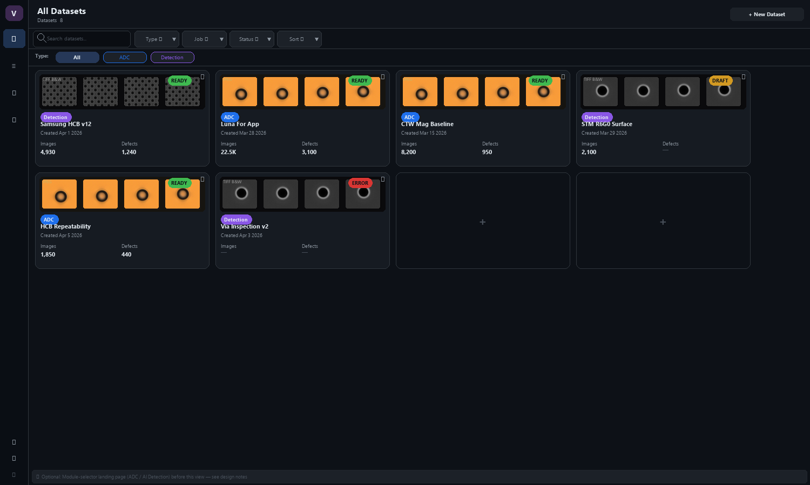
Screen 1 — Dataset Inventory
Notes:
All datasets in a card grid. Blue badge = ADC, Purple badge = AI Detection. Filter chips to narrow by type/status. Alt: module-selector landing page (shown in footnote).

Slide 17
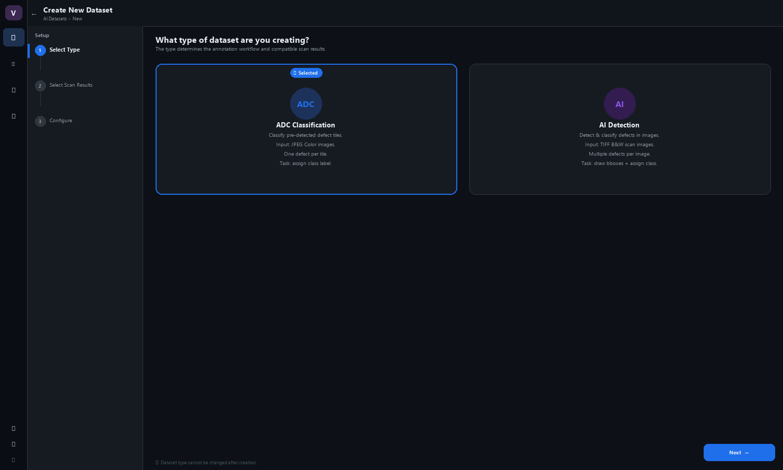
Screen 2a — Create Dataset: Select Type
Notes:
Step 1 of 3 in the New Dataset wizard. User picks ADC Classification or AI Detection. Type cannot be changed after creation.

Slide 18
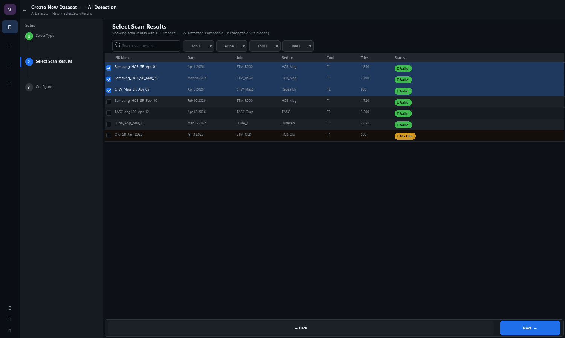
Screen 2b — Create Dataset: Select Scan Results
Notes:
Step 2 of 3. Scan results are auto-filtered to only show TIFF-compatible SRs for the chosen type. No manual path input needed. Multi-select with running tile count.

Slide 19
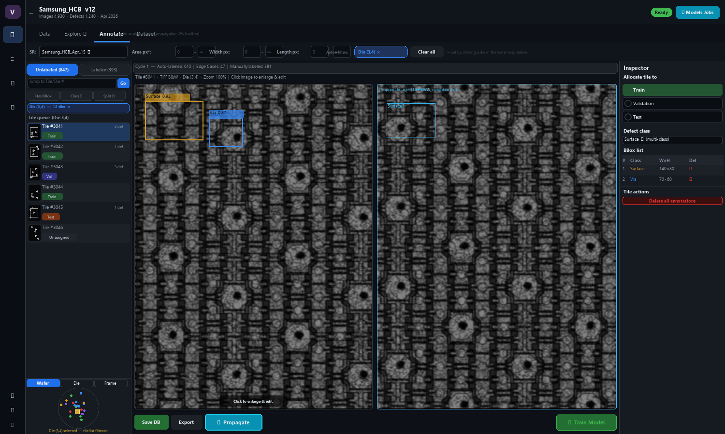
Screen 3 — Annotate Workspace (Annotation Mode)
Notes:
Primary hub for all annotation work. Full-width filter toolbar: SR origin + Area/Width/Length ranges. Die selection on wafer map filters tile list (shown with active 'Die (3,4)' chip — component connectivity). Tile queue shows only die-filtered tiles. TIFF B&W tile canvas with 'Click to enlarge & edit' hint. Propagation cycle stats bar. Explore tab = VL built-in (greyed).

Slide 20
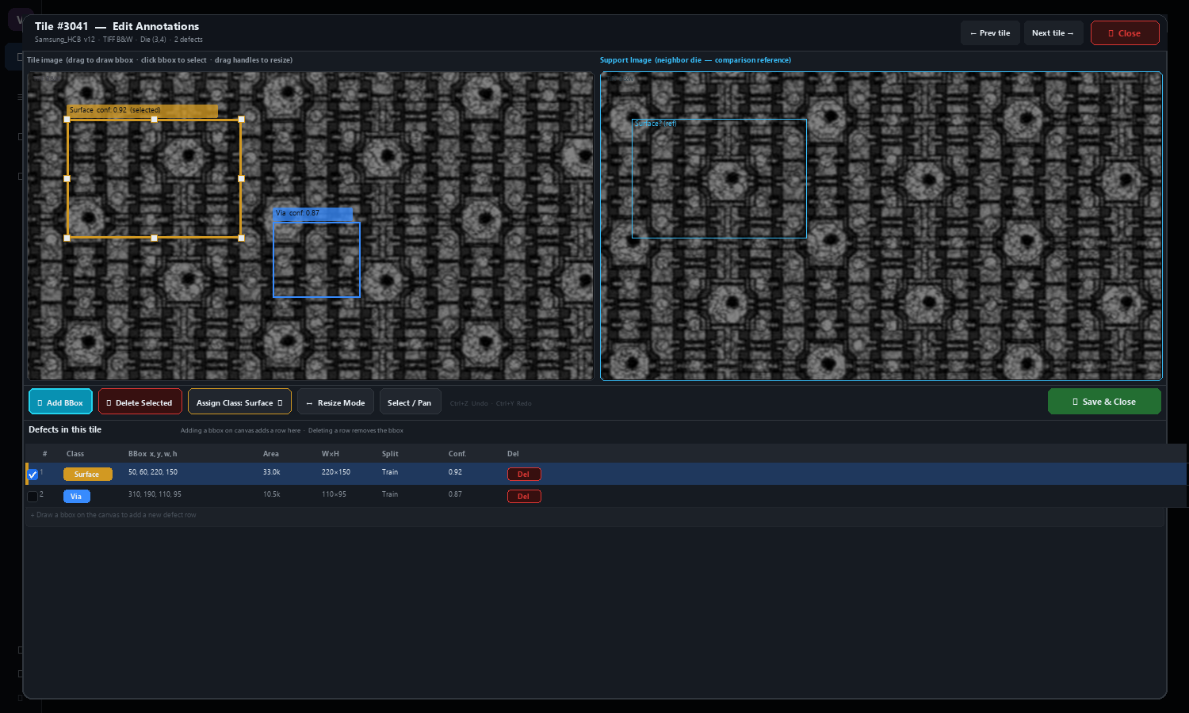
Screen 3b — Tile Editor Modal (Click to Enlarge)
Notes:
Full-screen modal that opens when user clicks a tile in the workspace. Left: enlarged TIFF B&W tile with selected bbox (orange, 8 resize handles) and unselected bbox. Right: support image (neighbor die, cyan border). Action bar: Add BBox | Delete Selected | Assign Class | Resize Mode | Select/Pan | Undo/Redo. Defect table below: each bbox = one row (x,y,w,h, area, split, conf, Del). Drawing a new bbox on canvas adds a row; deleting a row removes the bbox.

Slide 21
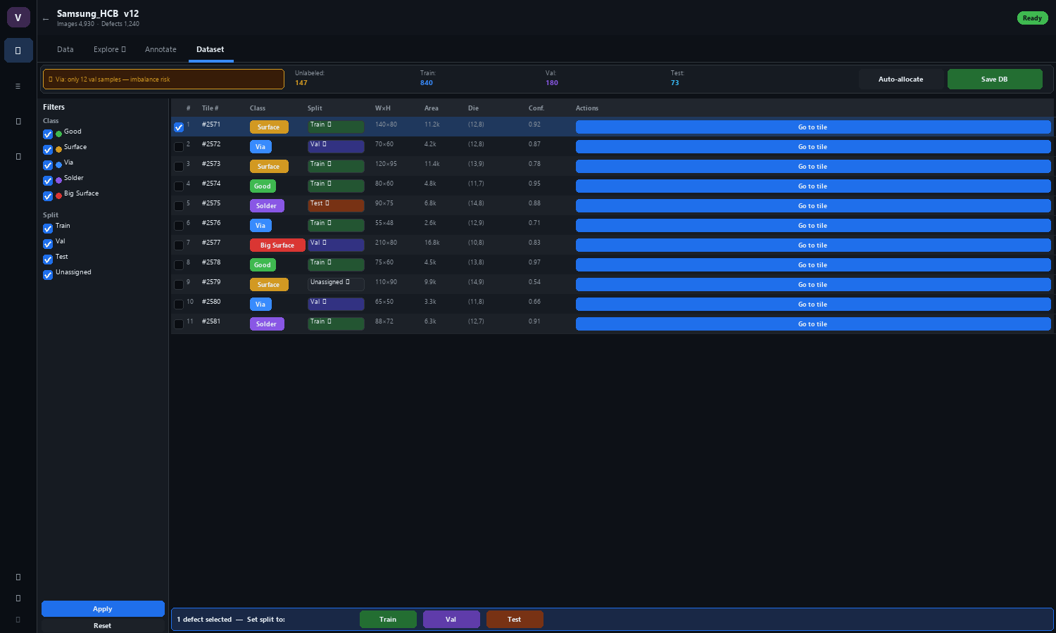
Screen 4 — Dataset Tab: Cross-Tile Defect Review
Notes:
4th tab in the annotation workspace. Shows all defects in a sortable table. Inline split dropdown per row. Go-to-tile button jumps back to Annotate tab. Bulk reassignment bar for multi-select. Auto-allocate modal triggers Screen 6.

Slide 22
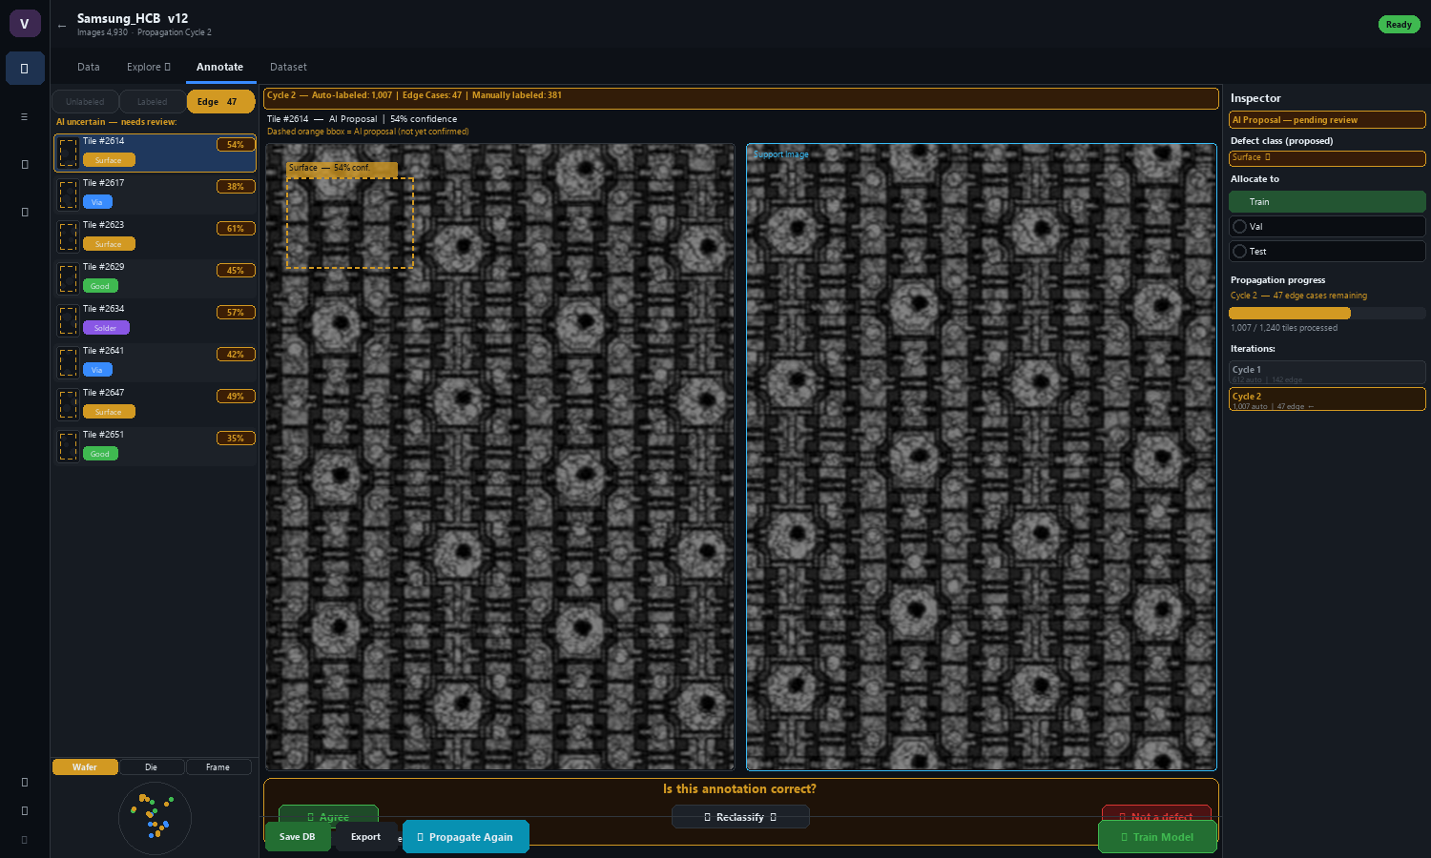
Screen 5 — Annotate Workspace (Propagation Review Mode)
Notes:
Same workspace after 'Propagate' finishes. Edge Cases tab (orange) lights up with uncertain tiles. AI proposals shown with dashed orange bbox. Review bar: Agree / Reclassify / Not a defect. Cycle stats track progress. Repeat until satisfied, then Train Model.

Slide 23
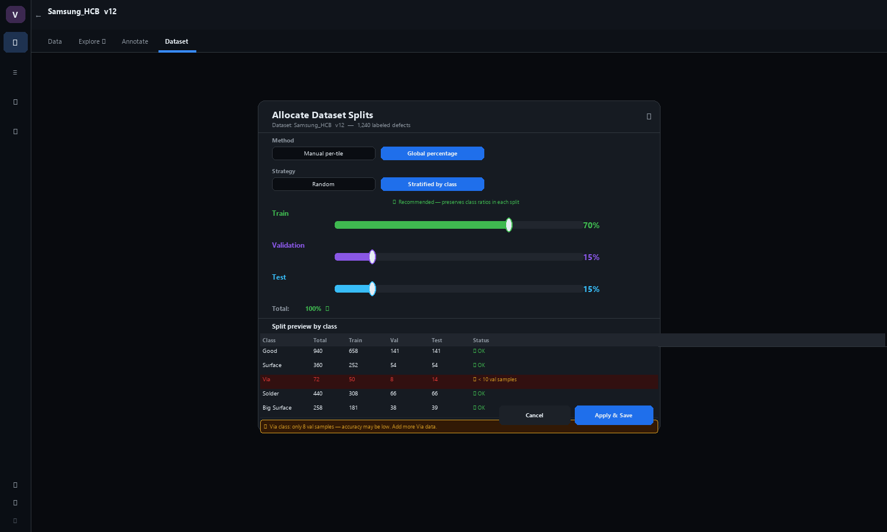
Screen 6 — Group Splits / Allocation Modal
Notes:
Opened from Dataset tab > Auto-allocate. Global percentage sliders (Train/Val/Test = 100%). Stratified by class recommended. Preview table highlights classes below minimum sample threshold.

Slide 24
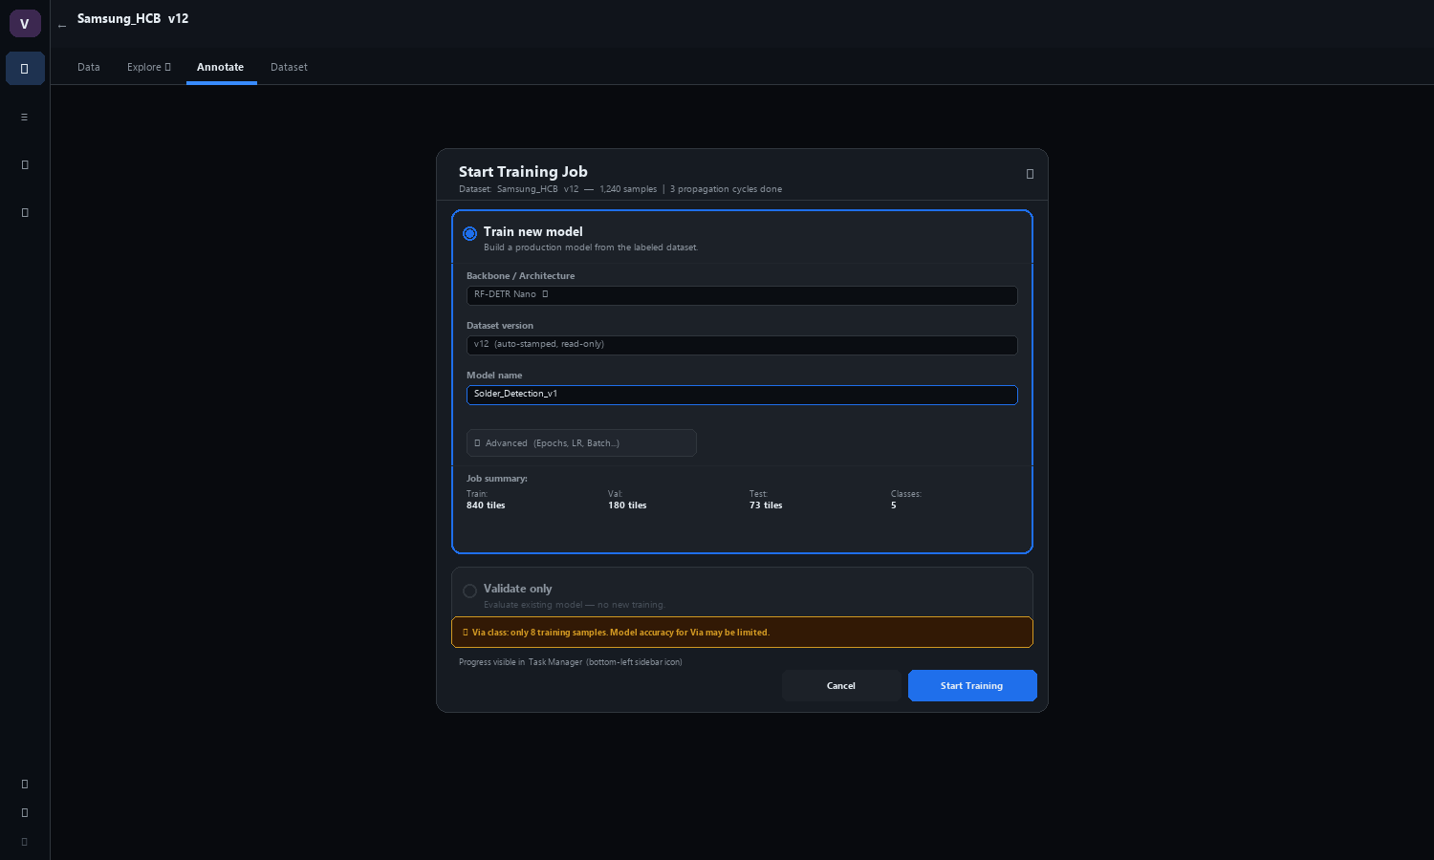
Screen 7 — Train Model Modal
Notes:
Triggered from 'Train Model' button in annotation toolbar. Selects backbone (RF-DETR Nano), dataset version, model name. Advanced config collapsed. Validate-only option available.

Slide 25
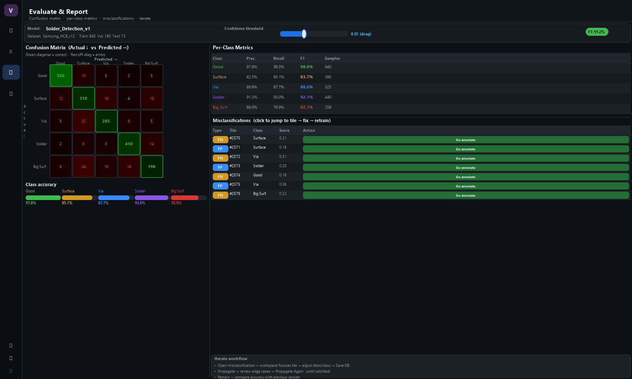
Screen 8 — Evaluate & Report
Notes:
5×5 confusion matrix with live threshold slider. Per-class precision/recall/F1. Misclassification table links back to annotation workspace for iterative refinement.

Slide 26
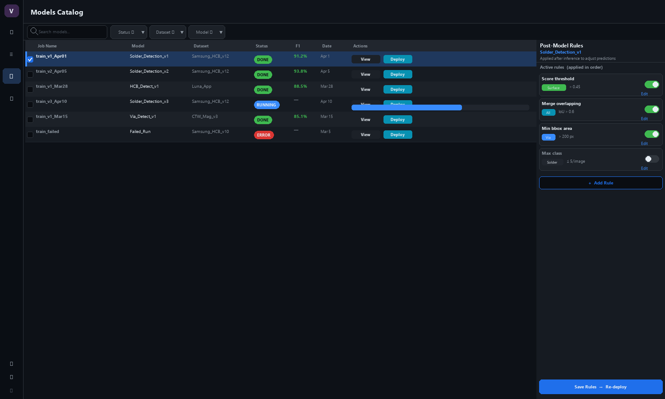
Screen 9 — Models Catalog + Post-Model Rules
Notes:
Training Jobs table (also Validation Jobs tab). Right side panel: Post-Model Rules editor. Rules: score threshold, merge overlapping, min bbox area, max class count. Toggle on/off per rule.

Slide 27
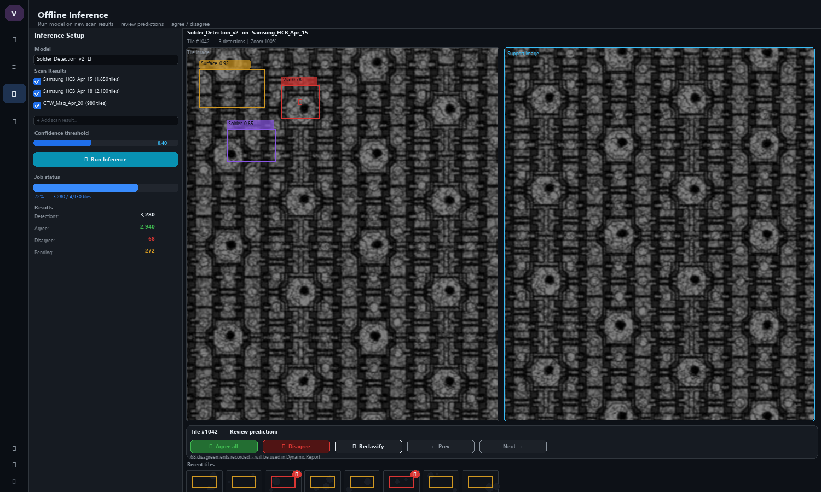
Screen 10 — Offline Inference
Notes:
Left: configure model + select SRs + confidence threshold. Right: tile canvas with predictions. Agree-all / Disagree / Reclassify controls. Disagreements recorded for Dynamic Report.

Slide 28
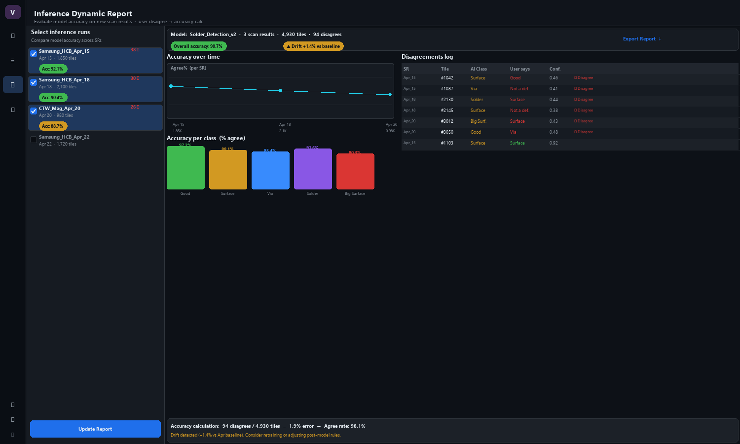
Screen 11 — Inference Dynamic Report
Notes:
Select inference runs from left panel. Accuracy trend line chart across SRs. Per-class accuracy bars. Disagree log table (AI class vs user correction). Accuracy calculation: agree% = 1 - (disagrees/total).

Slide 29
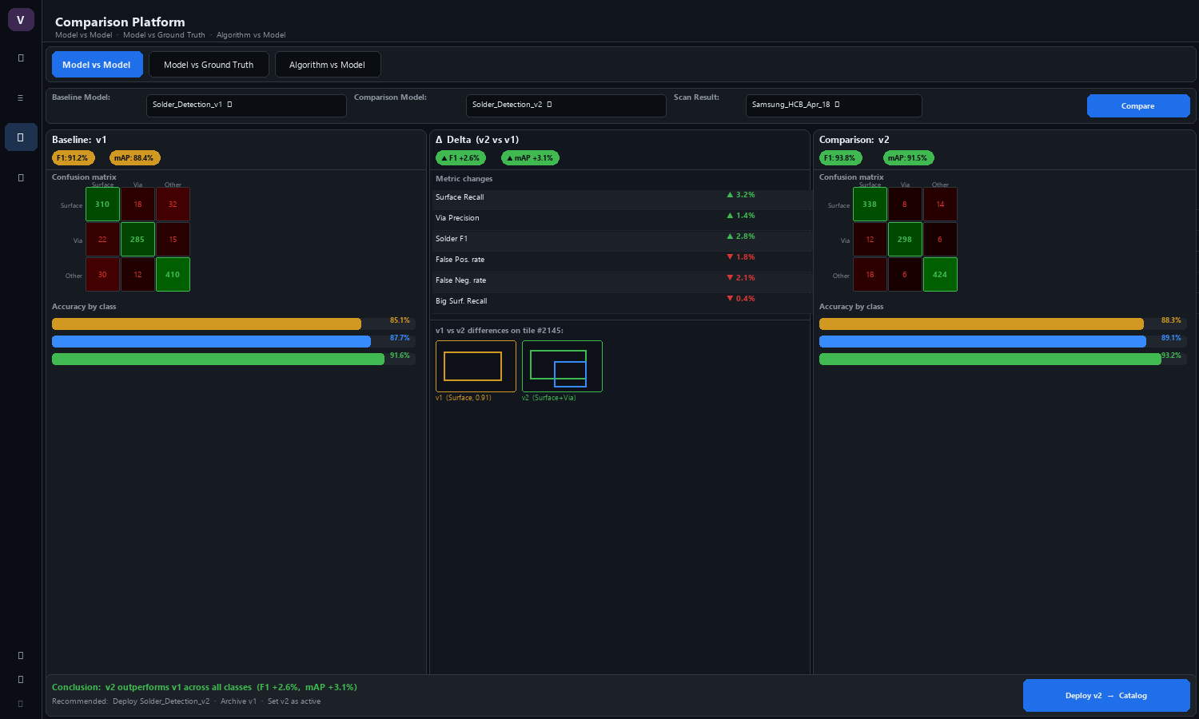
Screen 12 — Comparison Platform
Notes:
3 comparison modes: Model vs Model / Model vs Ground Truth / Algorithm vs Model. Side-by-side confusion matrices and per-class metrics. Delta panel shows improvement/regression. Tile-level diff examples. Deploy recommended model directly from this view.

